Slide 1


How effective is the current discount strategy?
Sabrina Reimann
Rachana Patel
Najib Bel-Lahsen
ivan curmi

Slide 2

92 %
Products have discount
The average discount is
21 %

Slide 3
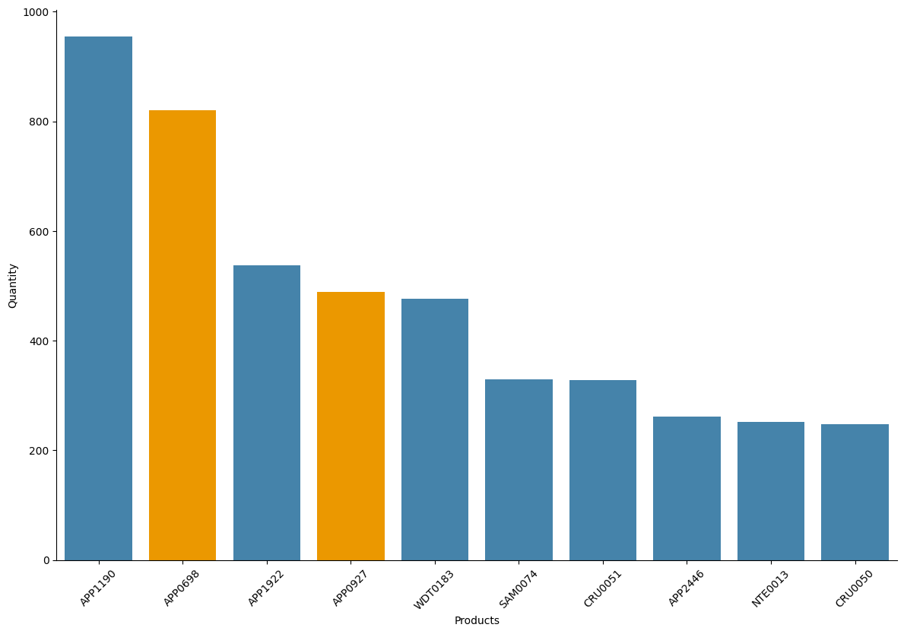
Most sold products
24%
is the average discount in the 25% top quantity sold

Slide 4
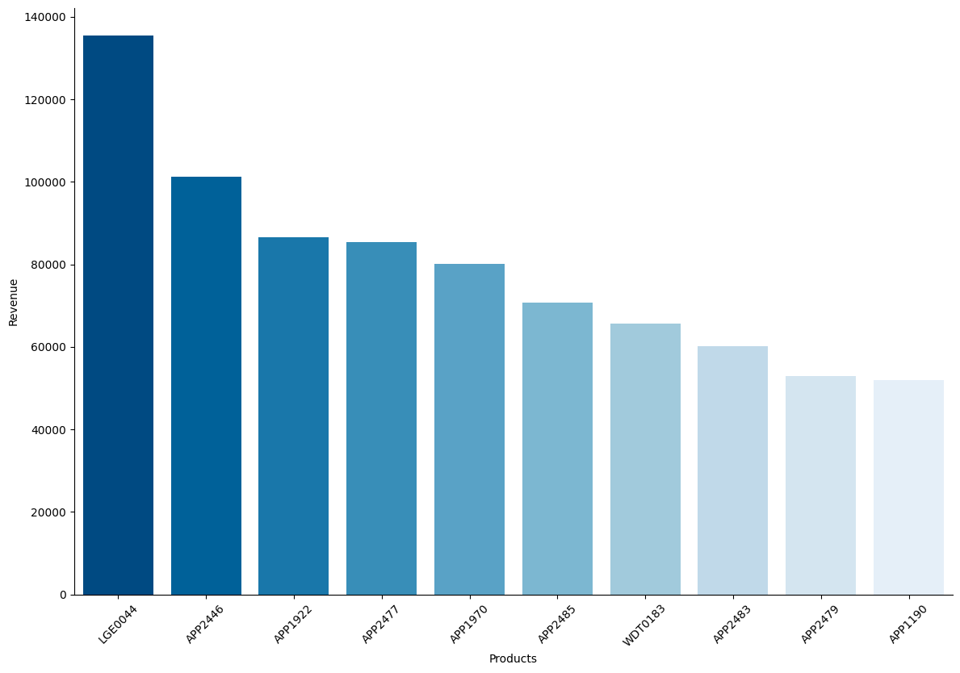
Products with most revenue
9%
is the average discount
in the 25% top revenue

Slide 5
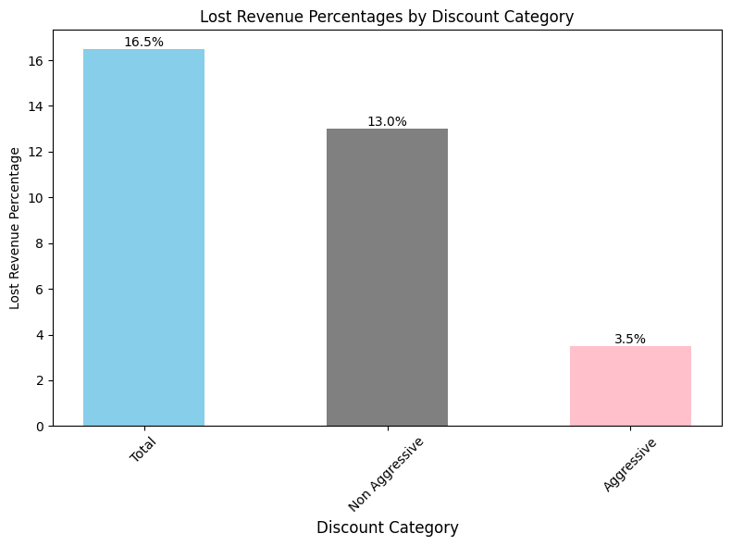
with an average aggressive discount of
56 %
present in
19 %
of total orders

Slide 6
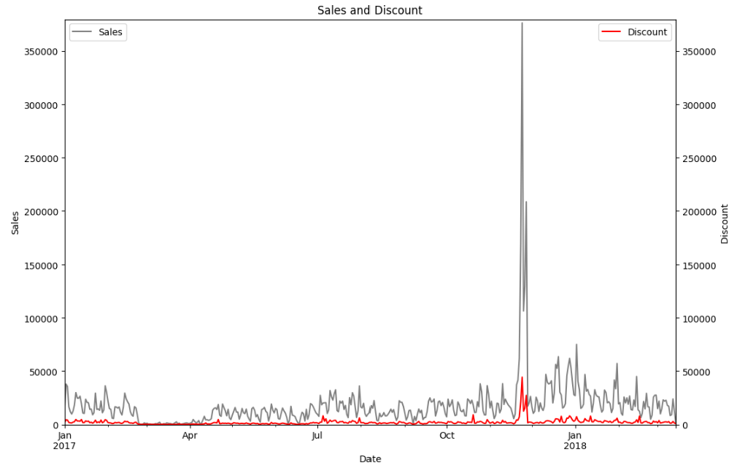
Revenues & Discounts over Time
Discounts are responsible for only a small proportion of revenue loss

Slide 7
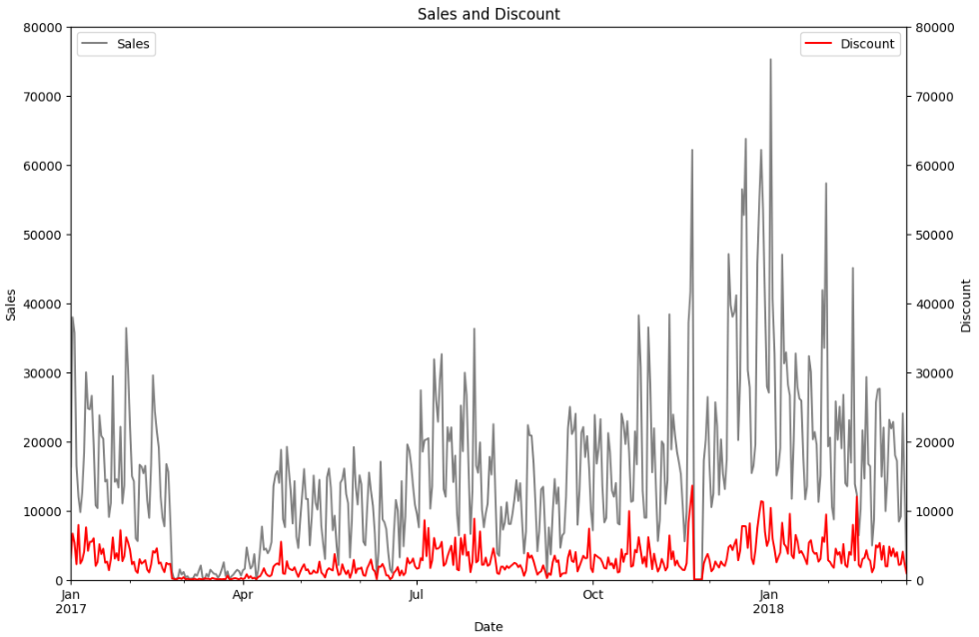
Revenues & Discounts over Time (w/o Black Friday)

Slide 8
Conclusion
High-revenue-generating products receive lower discounts
General revenue loss due to discounts is not high
Recommendation
Maintain the current discount strategy
No aggressive discounts for high-revenue-generating products
Improve data collection, by e.g. introduction of a uniform category catalog

Slide 9

THANK YOU FOR
YOUR ATTENTION

